Slide 1
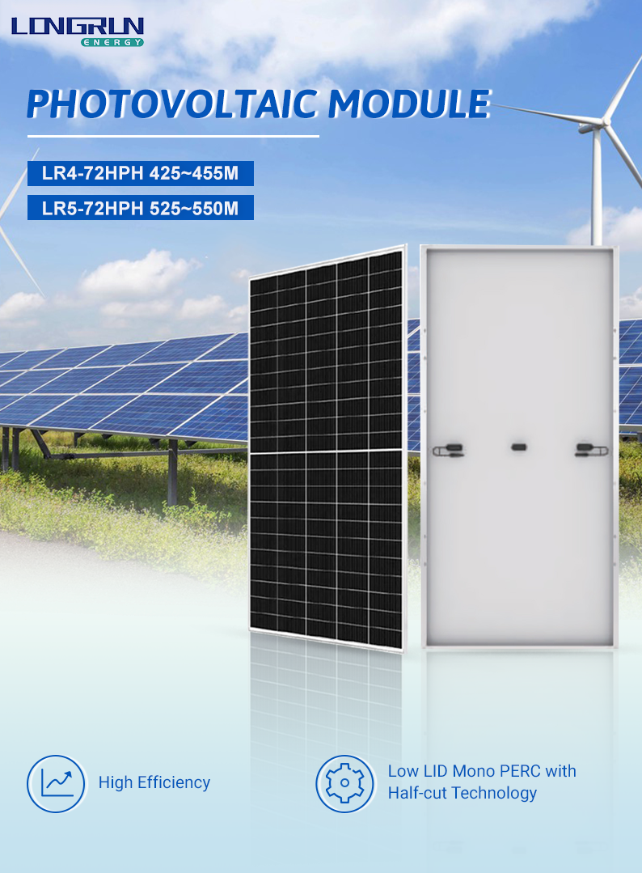

Slide 2
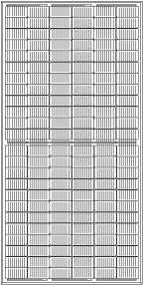
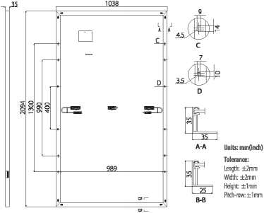
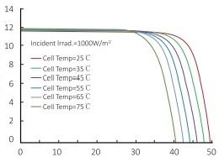
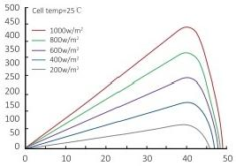
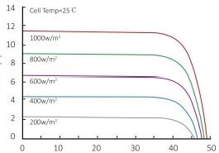
LR4-72HPH 425~455M
Design (mm)
Mechanical Parameters
Operating Parameters
Cell Orientation: 144(6x24)
Junction Bc»(: IP68, three diodes
Output Cable: 4mm²,300mm in length, length can be customized
Glass: Single glass
3.2mm coated tempered glass Frame: Anodized aluminum alloy frame Weight: 23.5kg
Dimension: 2094x1038x35mm
Packaging: 30pcs per pallet
150pcsper20/GP
660pcsper40'HC
Operational Temperature: -40 C ~+85C
Power Output Tolerance: 0~+5 W
Voc and Isc Tolerance: ±3%
Maximum System Voltage: DC1500V(IEC/UL)
Maximum Series Fuse Rating: 20A
Nominal Operating Cell Temperature: 45+2 C
Safety Oass: Class II
Fire Rating: ULtype lor2
Electrical Characteristics | Test uncertainty for Pmax: ±3%
Model Number | LR4-72HPH-425M |  | LR4-72HPH-430M |  | LR4-72HPH-435M LR4-72HPH-440M |  |  |  | LR4-72 H PH-445 M |  | LR4-72HPH-450M |  | LR4-72H PH-455M
Testing Condition | STC i | NOCT | STC | NOCT | STC i | NOCT | STC | NOCT | STC | NOCT | STC | NOCT | STC i | NOCT
Maximum Power (Pmax/W) | 425 | 317.4 | 430 | 321.1 | 435 | 324.9 | 440 | 328.6 | 445 | 332.3 | 450 | 336.1 | 455 | 339.8
Open Circuit Voltage (Voc/V) | 48.3 | 45.3 | 48.5 | 45.5 | 48.7 | 45.7 | 48.9 | 45.8 | 49.1 | 46.0 | 49.3 | 46.2 | 49.5 | 46.4
Short Circuit Current (Isc/A) | 11.23 | 9.08 | 11.31 | 9.15 | 11.39 | 9.21 | 11.46 | 9.27 | 11.53 | 9.33 | 11.60 | 9.38 | 11.66 | 9.43
Voltage at Maximum Power (Vmp/V) | 40.5 | 37.7 | 40.7 | 37.9 | 40.9 | 38.1 | 41.1 | 38.3 | 41.3 | 38.5 | 41.5 | 38.6 | 41.7 | 38.8
Current at Maximum Power (Imp/A) | 10.50 | 8.42 | 10.57 ! | 8.47 | 10.64 | 8.53 | 10.71 | 8.59 | 10.78 | 8.64 | 10.85 | 8.70 | 10.92 | 8.75
Module Efficiencyf%) | 19.6 |  | 19.8 |  | 20.0 |  | 20.2 |  |  | 20.5 |  | 20.7 | 20.9
STC (Standard Testing Conditions): Irradiance 1000W/m²_{z} Cell Temperature 25C, Spectra at AM 1.5
NOCT (Nominal Operating Cell Temperature)： Irradiance 800W/m², Ambient Temperature 20C, Spectra at AM 1.5, Wind at lm/S
Temperature Ratings (STC)
Mechanical Loading
Temperature Coefficient of Isc
+0.048%/C
Front Side Maximum Static Loading
Rear Side Maximum Static Loading
Hailstone Test
5400Pa
2400Pa
25mm Hailstone at the speed of 23m/s
Temperature Coefficient of Voc
-0.270%/C
Temperature Coefficient of Pmax
-0.350%/C
l-V Curve
Current-Voltage Curve (LR4-72HPH-440M)
Power-Voltage Curve (LR4-72HPH-440M)
Current-Voltage Curve (LR4-72HPH-440M)

Slide 3
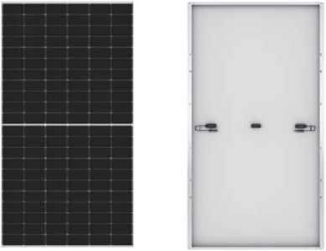
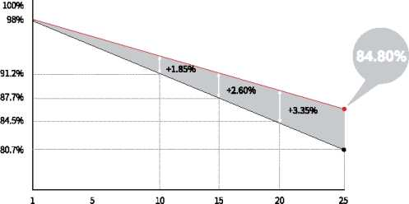
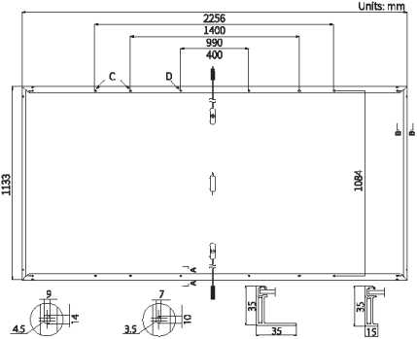
Hi-MO
5m
LR5-72HPH 525~550M
21.5%
MAX MODULE EFFICIENCY
0-+5W
POWER TOLERANCE
<2%
FIRST YEAR POWER DEGRADATION
0.55%
HALF-CELL
Lower operating temperature
YEAR 2-25
POWER DEGRAD/VTION
Additional Value
25-Year Power Warranty
Mechanical Parameters
Cell Orientation | 144(6X24)
Junction Box | IP68, three diodes
Output Cable | 4mm², positive 400 / negative 200mm length can be customized
Glass | Single glass, 3.2mm coated tempered glass
Frame | Anodized aluminum a Hoy fra me
Weight | 27,2kg
Dimension | 2256 X1133 X 35mm
Packaging | 31pcs per pallet/ 155pcs per20* GP/620pcs per40* HC
Electrical Characteristics stc：ami5 iooow/肝 25°。 ~festuncertaimyfo「Pma)c 土 3%
Power Class | 525 | 530 | 535 | 540 | 545 | 550
Maximum Power (Pmax/W) | 525 | 530 | 535 | 540 | 545 | 550
Open Circuit Voltage (Voc/V) | 49.05 | 49.20 | 49.35 | 4950 | 49.65 | 49.80
Short Circuit Current (Isc/A) | 13.65 | 13.71 | 13.78 | 13.85 | 13.92 | 13.98
Voltage at Maximum Power (Vmp/V) | 41.20 | 4135 | 41.50 | 41.65 | 41.80 | 41.95
Current at Maximum Power (Im p/A) | 12.75 | 12.82 | 12.90 | 12.97 | 13.04 | 13.12
Module Efficiency(%) | 20.5 | 20.7 | 20.9 | 21.1 | 213 | 21.5
Operating Parameters
Mechanical Loading
Operational Temperature | -40<,C-+85°C
Powe r O utpu t Tolerance | 0-+5W
Voc and 1 sc Tolerance | ±3%
Maximum System Voltage | DC1500V (IEC/UL)
Maximum Series Fuse Rating | 25A
Nominal Operating Cell Temperature | 45±2⁸C
Protection Class | Class II
Fire Rating | ULtype lor2
Front Side Maximum Static Loading | 5400Pa
Rear Side Maximum Static Loading | 2400Pa
HailstoneTest | 25mm Hailstone at the speed of 23m^
Temperature Ratings (STC)
Temperature Coefficient of Isc | W.04a%/°C
Temperatu re Coefficient of Voc | -0.270%/^{fl}C
Temperature Coefficient of Pmax | -0.350%/°C

